Slide 1


EC311 Final Presentation:
Stand-off
Group 7: Wild West
Federico Coppo
Suyash Bhatia
Guillermo Ao
Daniel Cabrera
Nancy Zheng
Notes:
Nancy

Slide 2
Goal/Motivation
Our implementation of Stand-off is a two player game similar to a game we all know: Rock, Paper, Scissors. Stand-off is playable up to two people where each player has three options at the beginning of each round: shoot, reload, or duck. Just like Rock, Paper, Scissors, a specific result will occur based on the combination of moves made by both players. Starting with three lives and one bullet, a winner is determined when one player loses all three lives.
Our designed game can be used for two individuals to play a game of Stand-off with each other or for one person to play with the computer for leisure/fun. We chose Stand-off for our project because we wanted to implement a simple, fun, and interactive game that only required at least one player. The rules are easy to learn and it is a relatively fast game so multiple rounds can be played. Stand-off requires two individuals to play in real life, so our design allows one individual to play with the computer.
Our design can be used for a fast and fun game with friends. Just like how Stand-off is an altered version of Rock, Paper, Scissors, the layout of our design can be used to implement other games with similar rules.
Notes:
Nancy

Slide 3


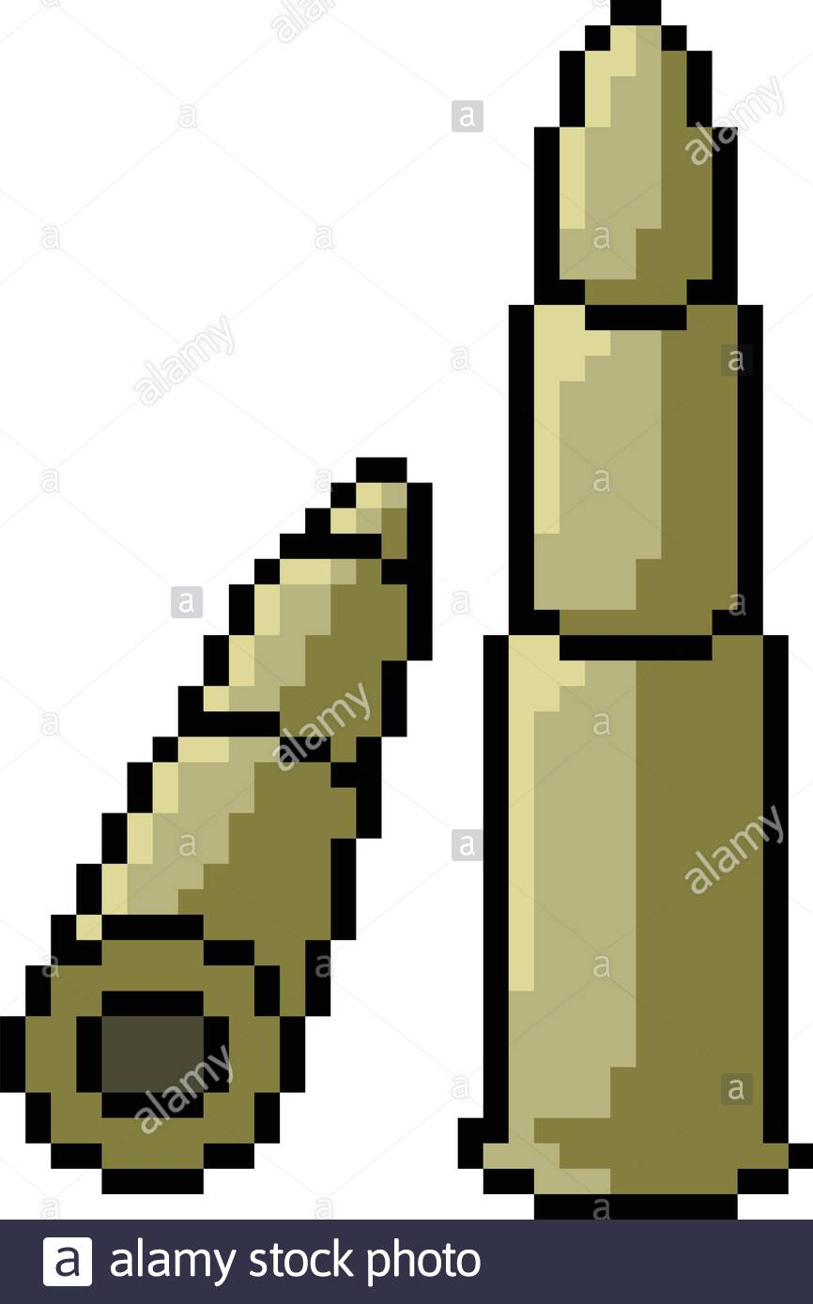
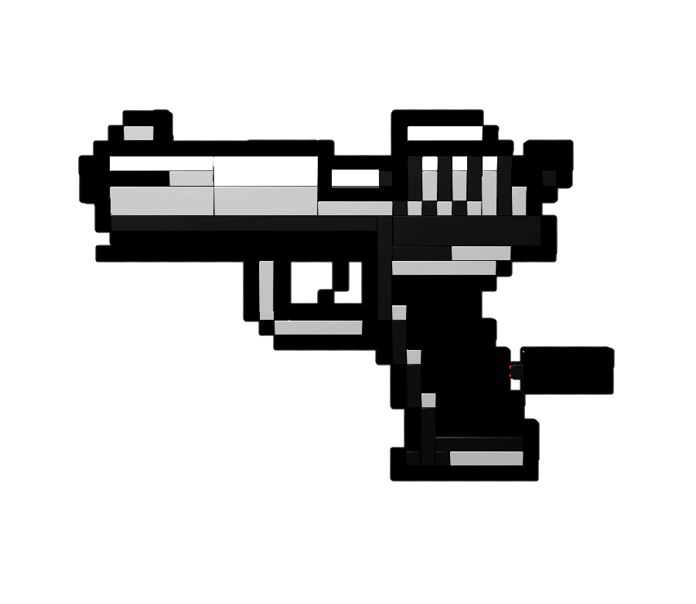

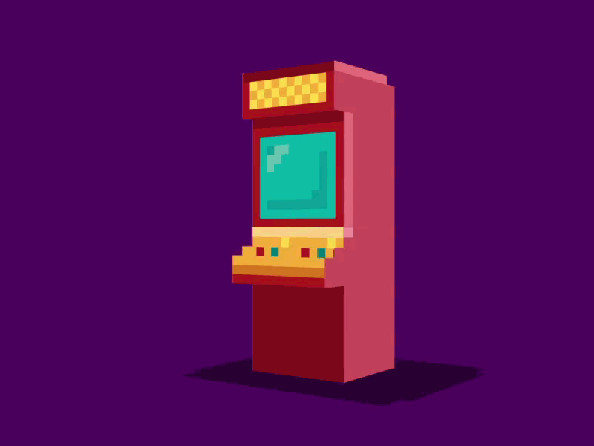


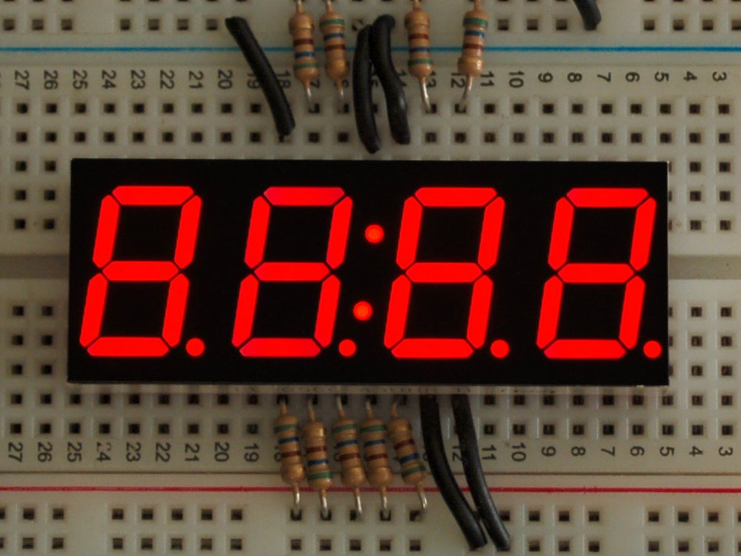
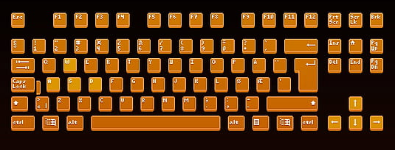
Functionality
P1
P2
X3
X1
vs.
P1
CPU
vs.
Keyboard for inputs (3 ops)
Counter/ Outcome of the Game
Notes:
Nancy
Amount of lives: displayed in LEDs
Amount of bullets: not shown to keep the game fair and fun
Keyboard: 3 inputs for each player (gun, duck, reload) total of 6 inputs
7seg: Displays a countdown for player(S) to make a decision, Displays outcome of the game (P# died, etc.)
Player wins if the opponent loses all 3 lives

Slide 4
Possible Outcomes
Player 1 | Player 2 | Result
Shoot | Shoot | Both players lose a bullet, no one loses
Duck | Duck | Nothing
Reload | Reload | Both players gain a bullet
Shoot | Duck | Player 1 loses a bullet
Duck | Shoot | Player 2 loses bullet
Shoot | Reload | Player 1 loses a bullet / Player 2 lose a life
Reload | Shoot | Player 2 loses a bullet / Player 1 lose a life
Reload | Duck | Player 1 gains a bullet
Duck | Reload | Player 2 gains a bullet
Special cases: If either player has zero bullets and chooses to shoot, nothing happens, but action counts as a turn.
If either player has three bullets in their barrel and chooses to reload, bullet count does not increase.
Notes:
Nancy

Slide 5
Specifications
Requirements | Constraints
Player chooses one of three moves (shoot, shield or reload) within a specific period of time | Can only be played up to two players (complicated to add another player)
Player needs to have bullet to shoot | Players cannot have more than three bullets in the barrel
Notes:
Federico

Slide 6
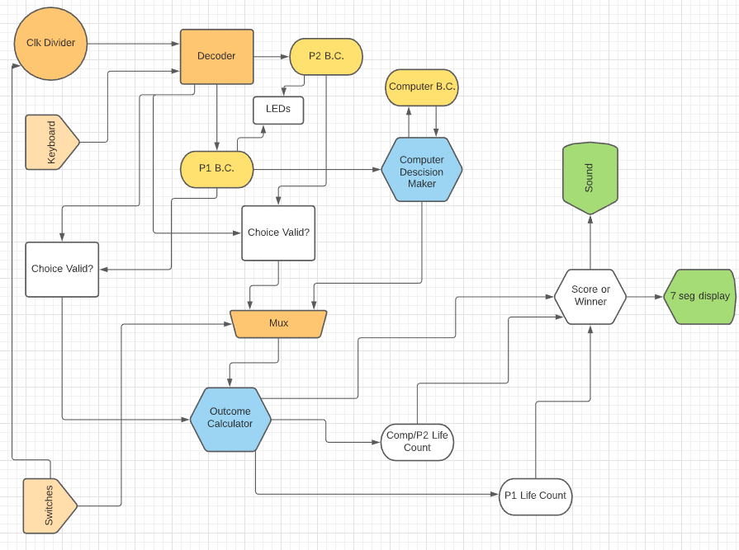
Full System Diagram
Notes:
Daniel

Slide 7
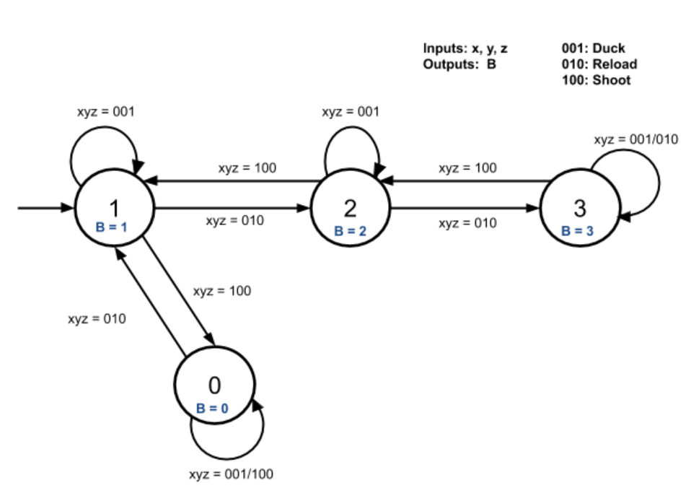
Finite State Machine: Number of Bullets
Notes:
Nancy
Number of Bullets FSM:
States are labeled based on their output (B) which also correspond to how many bullets are in the barrel
If a player ducks, no bullets are lost or gain so it will always go back to its current state,
If a player shoots, they will lose a bullet so they will go to the previous state. (Exception: if they are at state 0 and shoot, they stay at state 0 since they have no bullets)
If a player reloads, they gain a bullet and move to the next state. (Expception: if they are at state 3 and reload, they will stay at state 3 since the max number of bullets you can have is 3)

Slide 8
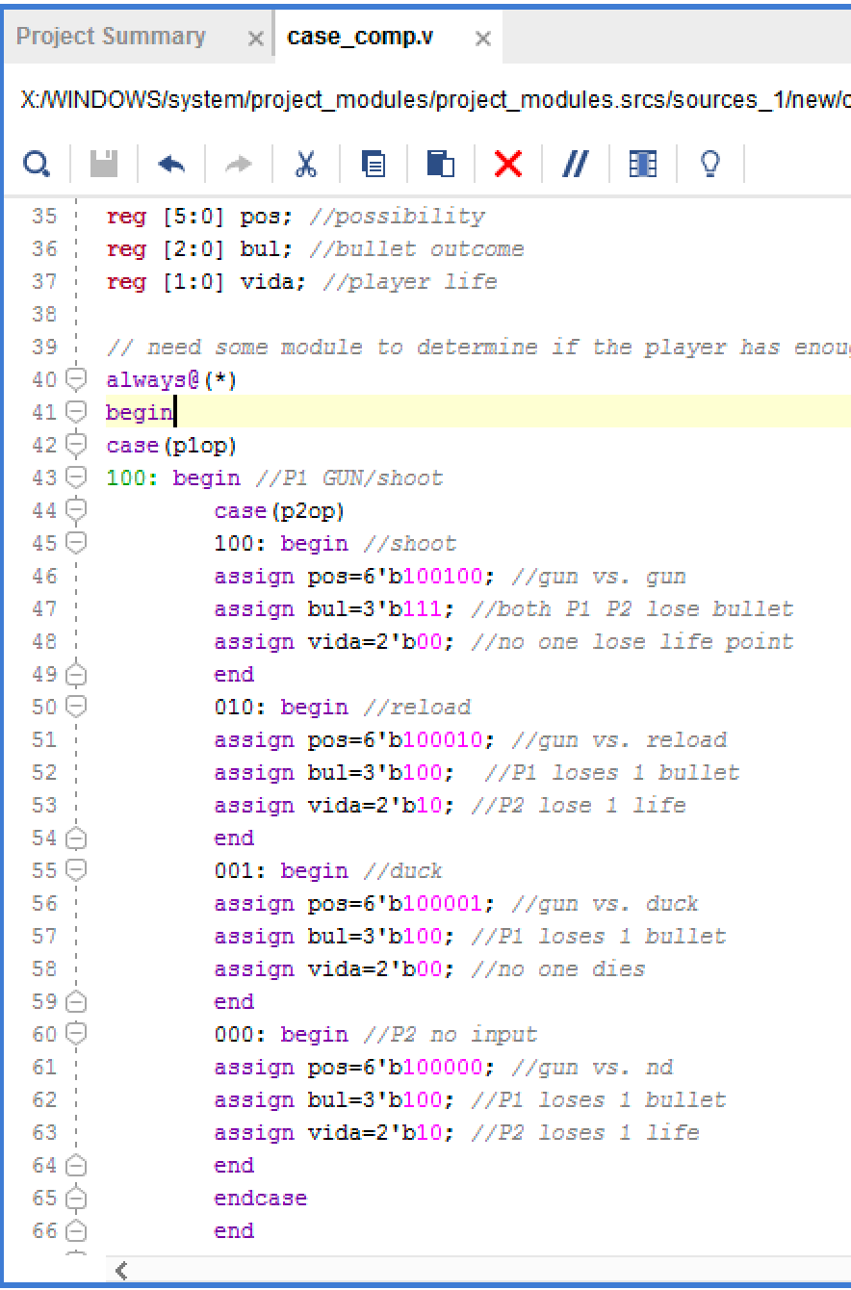
Match Outcome Module (Preliminary Design)
3 different outputs will go to their respective modules to process the information. These are:
Bullet count
Life count
Match outcome
Each has a different encoding and bit size.
The module will take 1 input from each player.
(100 shoot, 010 reload, 001 duck) Then, these will be evaluated with case statements to generate the outputs.
Notes:
Guillermo: case statement code for game functionality

Slide 9
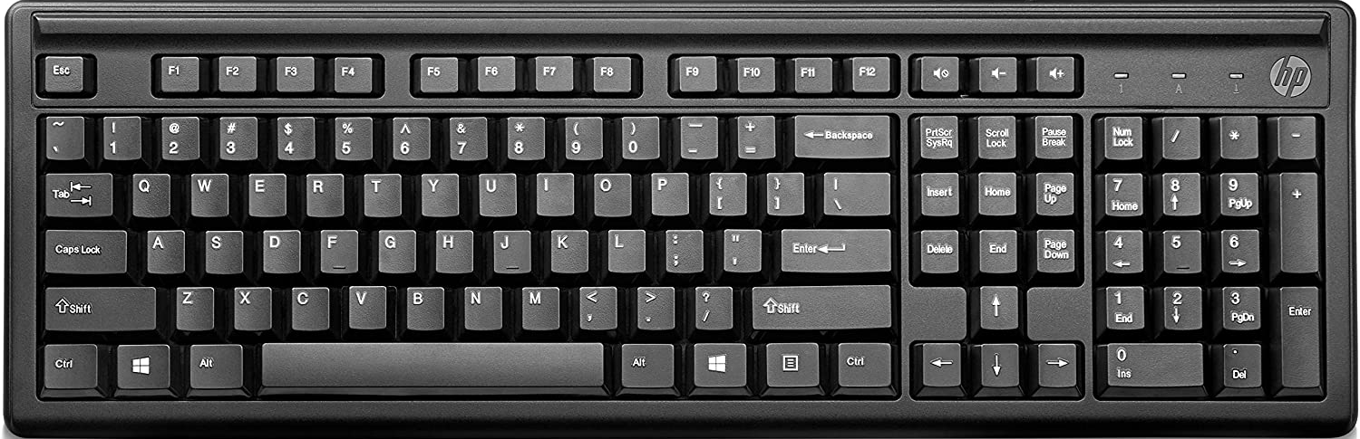
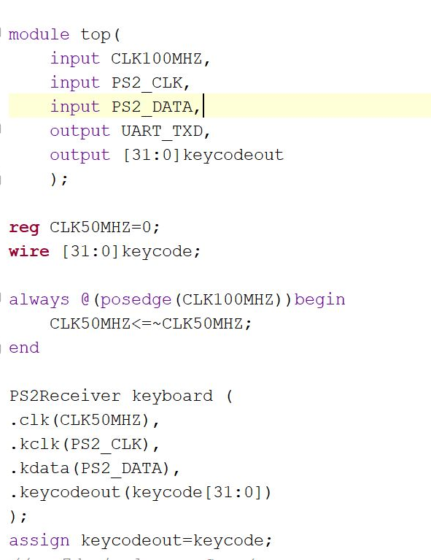
Keyboard Module
This is the basic structure of how the keyboard works
What the variables do:
CLK100MHZ: Clock generated by the FPGA board
PS2_CLK: Clock of the Keyboard
PS2_DATA: Data from the keyboard(it comes bit by bit)
UART_TXD: Used to transmission of data from the keyboard.
Keycodeout: We manage to generate a unique 32 bit code which tells us which of the last two keys were pressed
Additionally, out ps2 receiver is instantiated here. It takes the given shown data and returns the 32 bit code.
Notes:
Suyash
Universal asynchronous receiver transmitter

Slide 10

PS2 Receiver
Even Though the code is ready, I have chosen to conceptually explain how the keyboard receives and captures the 16 digit code of each key.
Firstly, it instantiates a debouncer to correctly capture the data coming from the keyboard.
Since the keyboard sends data in two parts we input 8 bit code in a current data register. (it comes in two parts because once the key is released it sends 8 more bits which are typically ‘F’ and ‘0’ in hex or “11110000” in binary).
Since we want to know if two keys were pressed at the same times by two users, we store 16 bits for two keys pressed at all times.
Each time a new key is entered it replaces the data of the key entered before the last key.
Notes:
Suyash

Slide 11
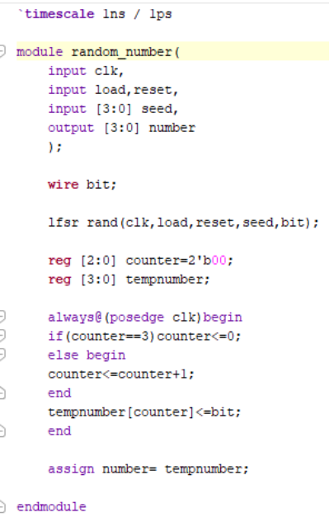
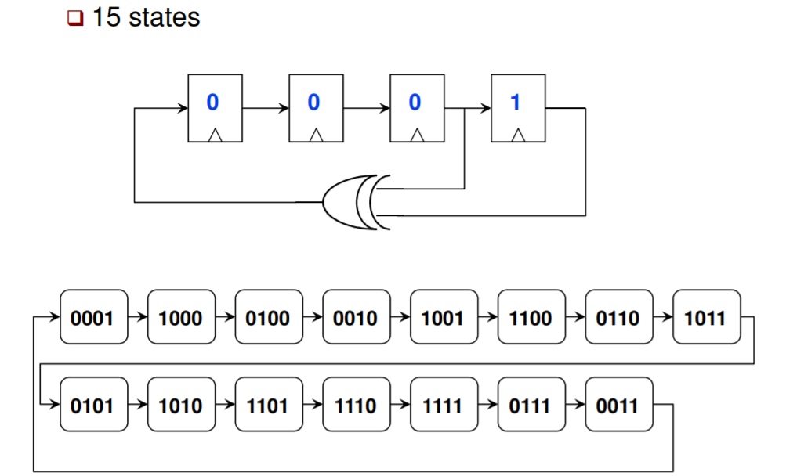
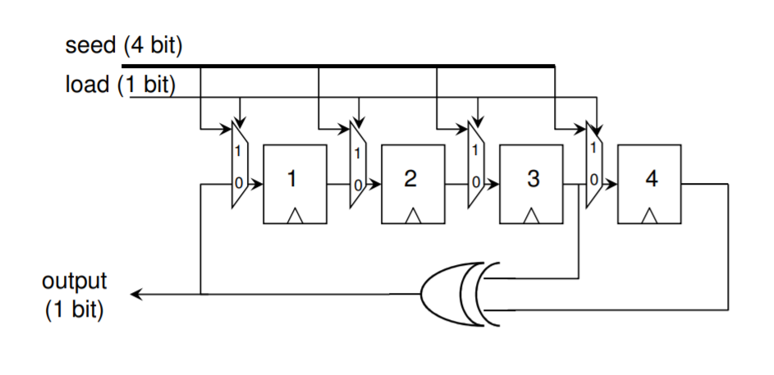
Randomizer (LFSR)
Capturing the bits
Notes:
Daniel

Slide 12
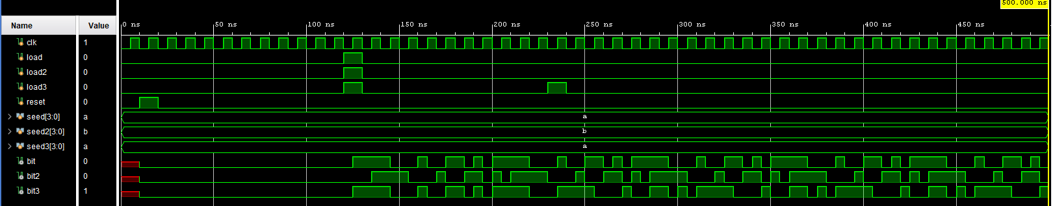
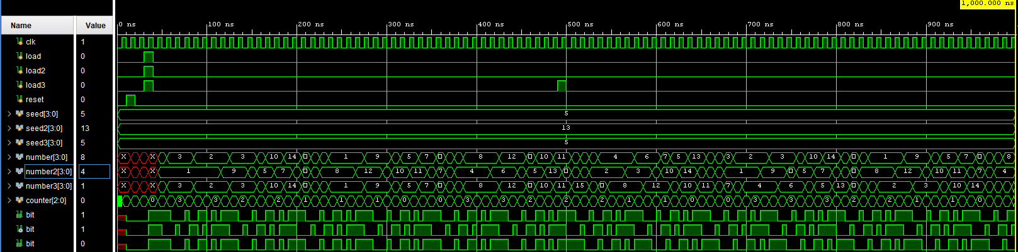
LFSR Waveform
Random # Generator Waveform
Notes:
Daniel

Slide 13
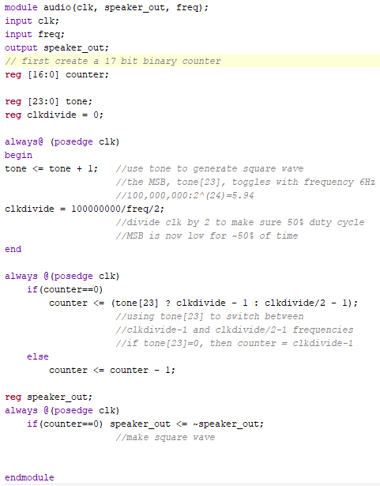
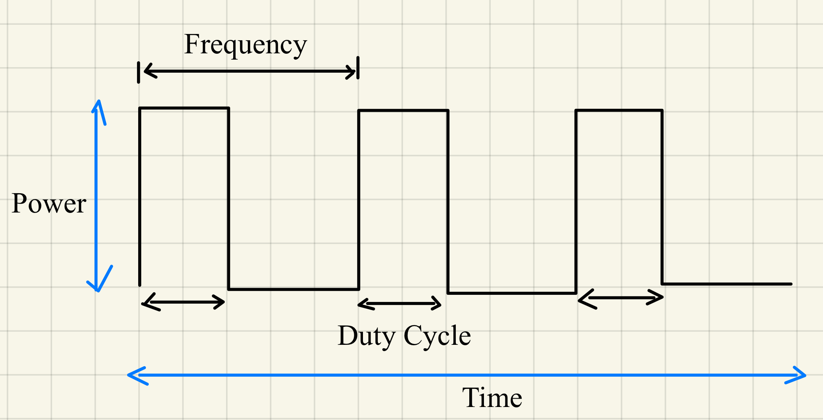
Audio Module
Pulse Width Modulation for Audio
Input desired max frequency as freq
Oscillation between 2 frequencies at output
Notes:
Federico:
Module takes in clock and desired frequency
Module can be called to output sound at desired frequency, or to alternate between two frequencies
Output signal obtained by the varying MSB of the counter

Slide 14
Successes/ Expectations
Game structure is determined (rules, system diagram, fsm)
A keyboard was implemented to the FPGA and successfully functioned to input the player’s option (shoot, reload, or duck).
Audio code was tested on FPGA and successively produces sound at mono audio out
Randomizer (LFSR) is working properly and it has been tested. Need to work on the implementation to the system so player can play against the computer.
We expect to be able to implement all the modules created to have the overall game structure work properly.
Notes:
Guillermo

Slide 15
Failures
We haven’t connected the keyboard inputs with the main module, but we are thinking to use a decoder to have the options: shoot, duck, and reload.
We are still working on setting up the specific sounds for output by using the audio module.
We are currently working on creating and setting up the modules to have the game ready!
Check back Dec 9th for more !

Slide 16
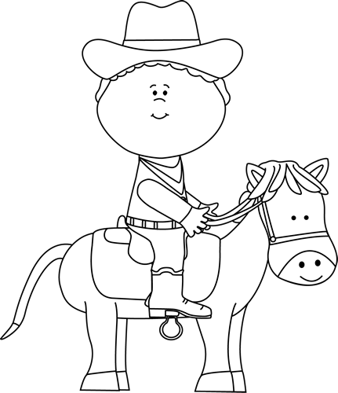
Thank you for Listening!
Questions?

Slide 17
Resources
Powerpoint on lfsr:
http://rdsl.csit-sun.pub.ro/docs/PROIECTARE%20cu%20FPGA%20CURS/lecture6[1].pdf

Slide 18
Short Functionality
*decided not to include this slide b/c too many words and used slide with graphics instead
Layout: Player can decide whether to play with another player or against the computer. If the user chooses to play against the computer, the idea is to implement a LFSR to generate random inputs. Each player will start with three lives and one bullet in the barrel. The amount of lives each player has will be indicated by the LEDs. Amount of bullets will not be displayed to keep it private and fair from the other player so players have to remember how many bullets they have left.
Inputs: We will be utilizing the keyboard for the player(s) to input moves. 3-6 keys on the keyboards will be used depending on if there is one or two players (three keys per player). Each of the three keys per player will be designated to one action: shoot, reload, and duck.
Display: At the start of each round, a counter, displayed on the seven-segment display, will be used to signal when each player has decide his or her move (time allowed: TBD). Based on the combination of moves, the appropriate result will occur (ex: if player choose to reload and is not at the max bullets, one bullet will be added but will not be shown). After each round, both player’s move will be displayed on the seven-segment display to avoid any confusion. A player has won when the other player has lost all three of his lives and the winner will be displayed on the seven-segment display.
Notes:
Don’t delete this yet

